Slide 1


Slide 2

Power of Story telling
Notes:
We are design to remember good stories

Slide 3

Less is more
Notes:
5 second rule

Slide 4
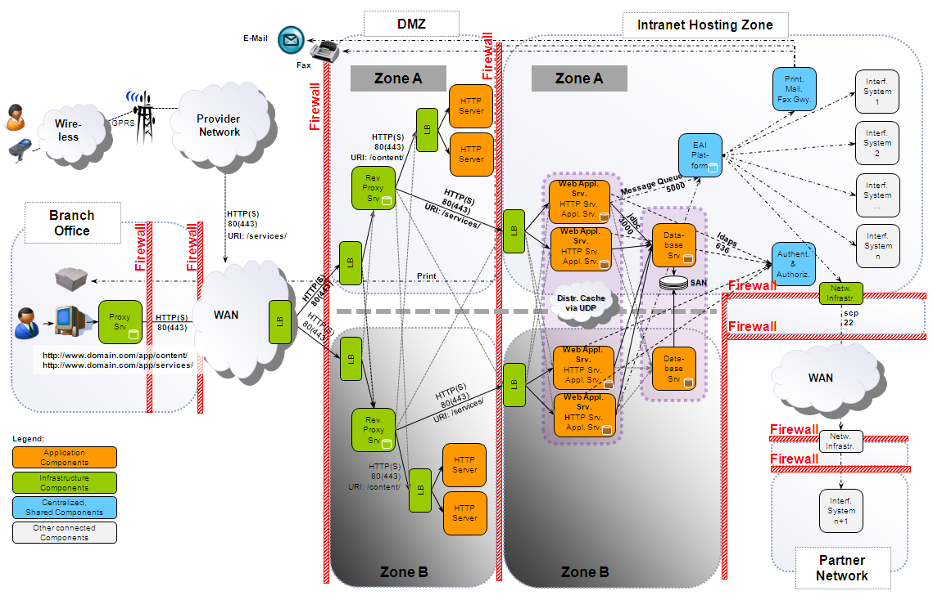
Notes:
5 second rule

Slide 5
Make good use of your resources
Notes:
Don McMillan

